Slide 1

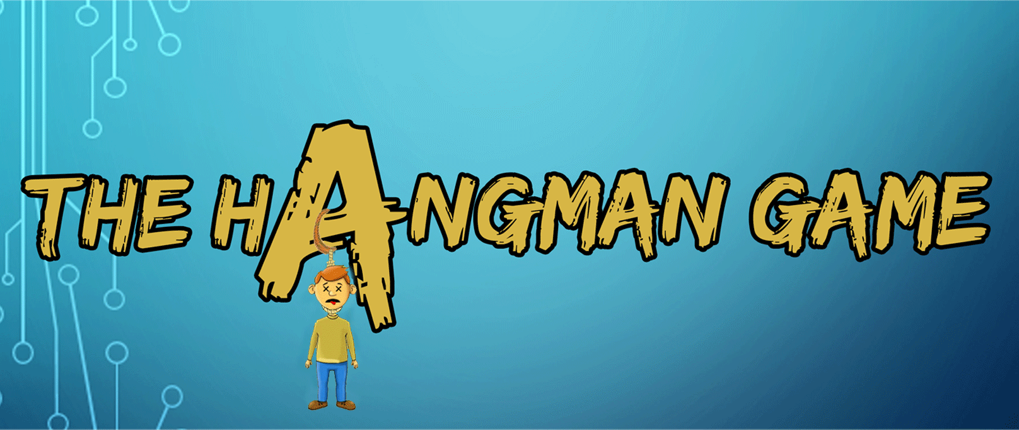
By,
Aayush Gour – 1608-16-733-062

Slide 2
INDEX
Introduction.
Objective.
System Specifications.
Modules.
Output.
Pros and Cons.
Conclusion.
Future Enhancements.
References.

Slide 3
ABSTRACT
The objective of this game is to guess the word correctly. The player will be given 5 chances to guess it right. In our project we have made 5 levels with increasing difficulty so that the player will be amused and also know new words. We have designed the code in such a way that the player gets a new word every time he plays the game. Every level has one question. If the player is able to guess the word within 5 chances, then he moves to the next level and he gets 5 chances to guess the next word. If the player fails to guess the word correctly, he gets a message about the correct word.

Slide 4
Introduction
Hangman is a paper and pencil guessing game for two or more players. One player thinks of a word, phrase or sentence and the other tries to guess it by suggesting letters or numbers, within a certain number of guesses.

Slide 5
objective
The main objective of this game is to create a game-like scenario around the course curriculum and the objectives of the course, specially English. The purpose of this game system is to promote student engagement and motivate students to enrich their vocabulary.

Slide 6
System specifications
Hardware requirements
Processor – ${\text{PENTIUM}\text{(}\text{II}\text{)}}^{\text{®}}$ or higher.
Processor Speed – Minimum of 1 GHz.
RAM – Minimum 512 MB.

Slide 7
System specifications
software requirements
Operating System – Windows XP, 7, 8, 8.1, 10.
IDE – Java Development Kit, Eclipse or Netbeans.

Slide 8
Modules
The whole game is divided into seven modules –
class Hangman()
Hangman()
void rand()
void init()
void compare()
void actionPerformed()
void paint()

Slide 9
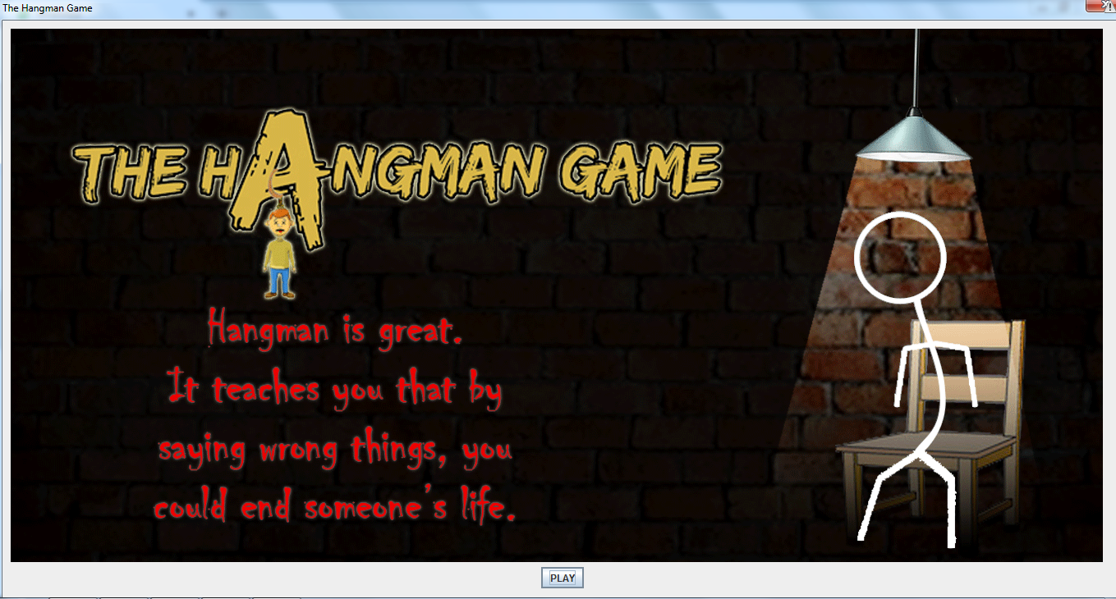
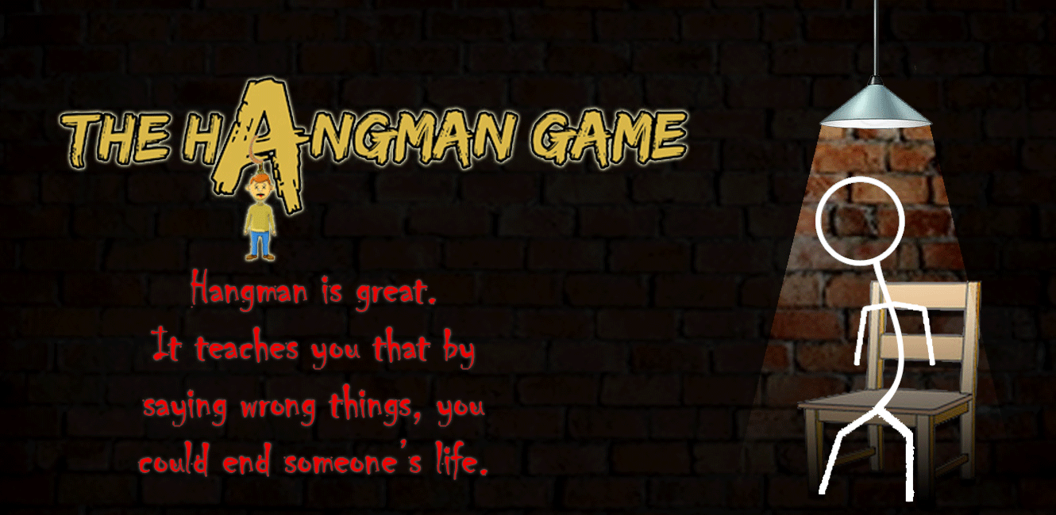
Output

Slide 10
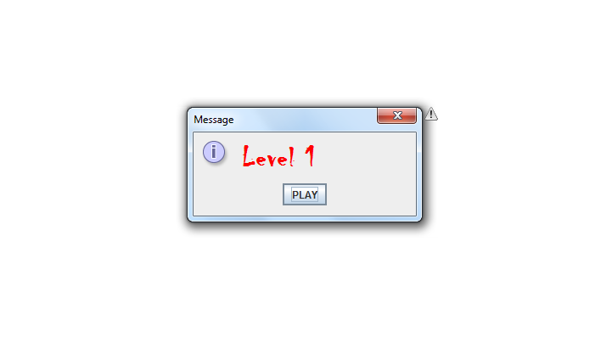

Slide 11
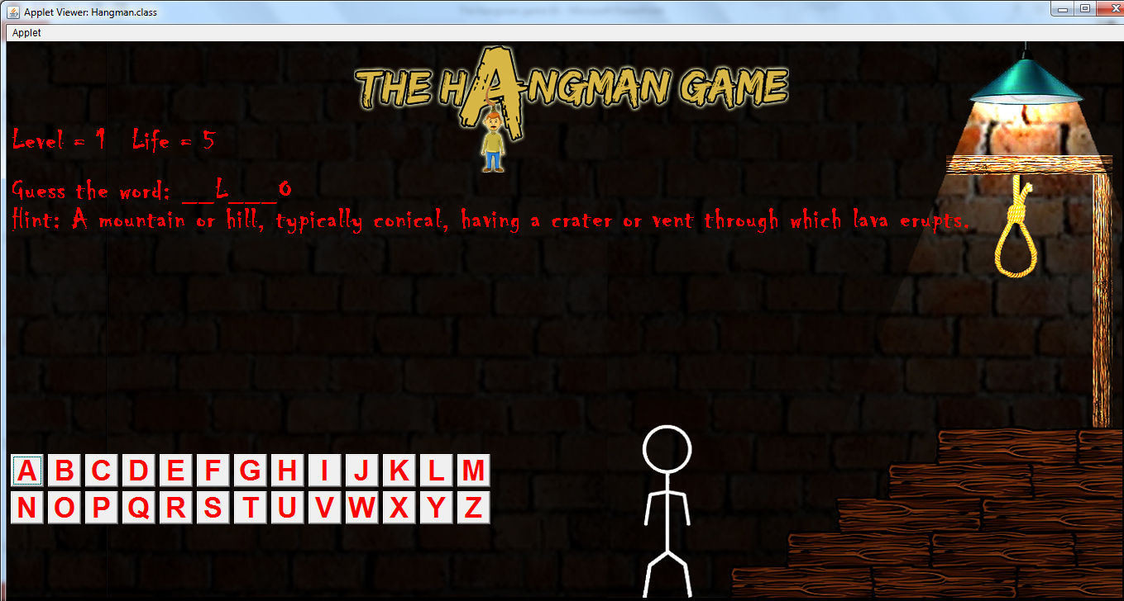

Slide 12
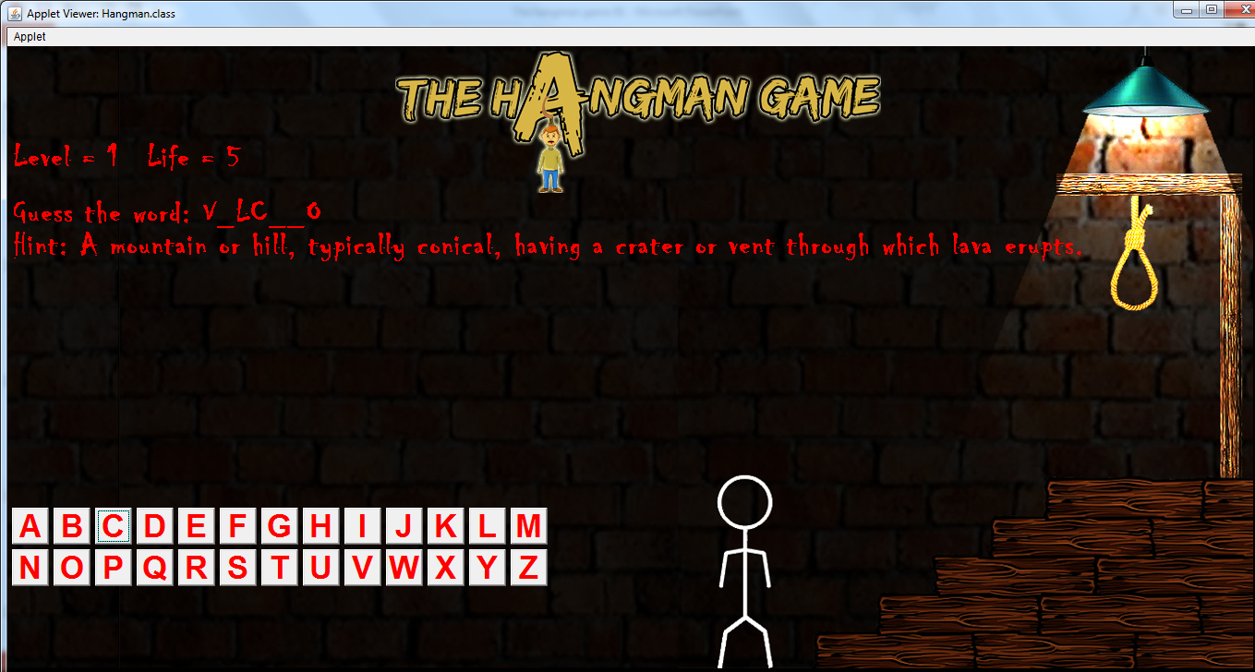

Slide 13
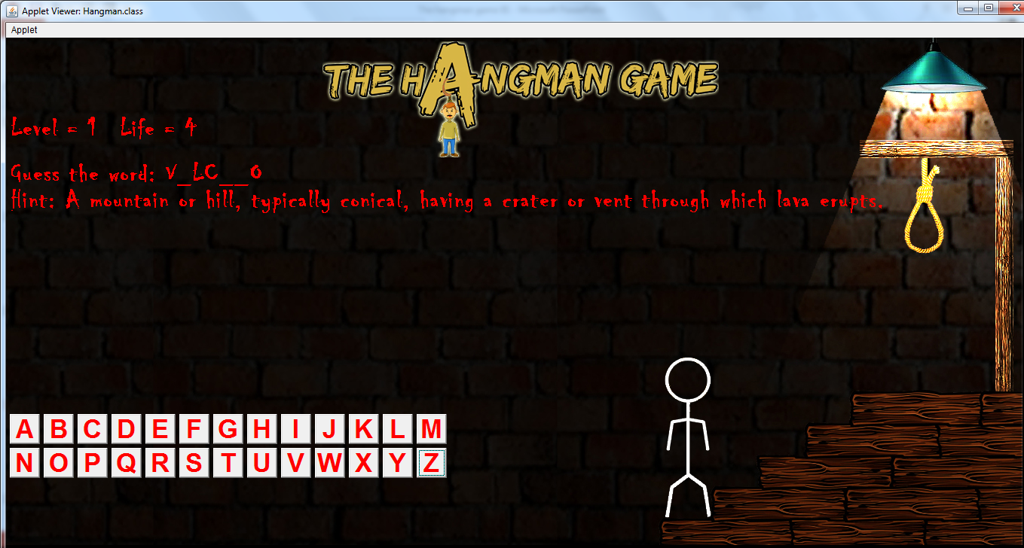

Slide 14
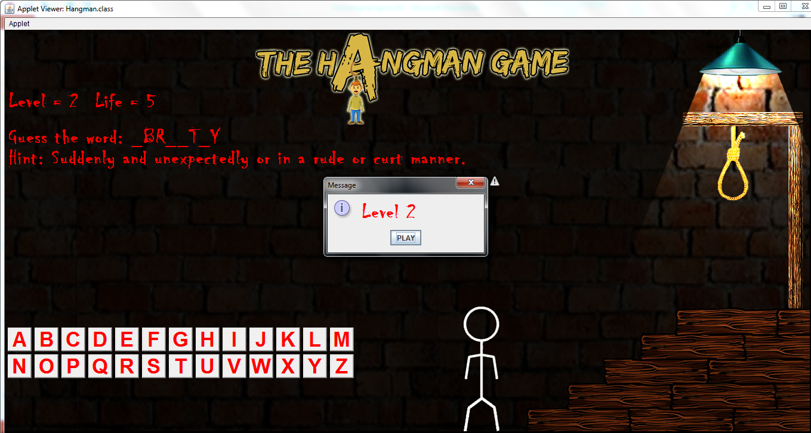

Slide 15
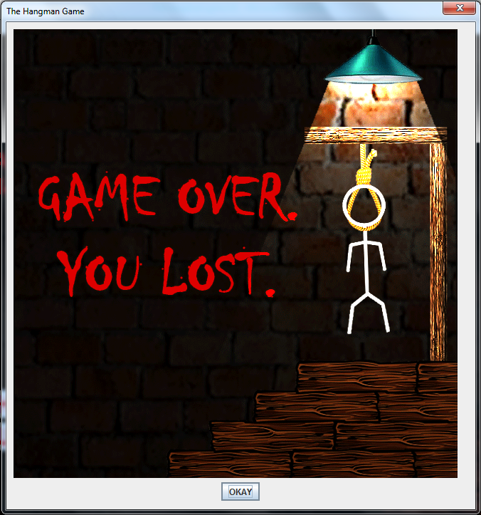
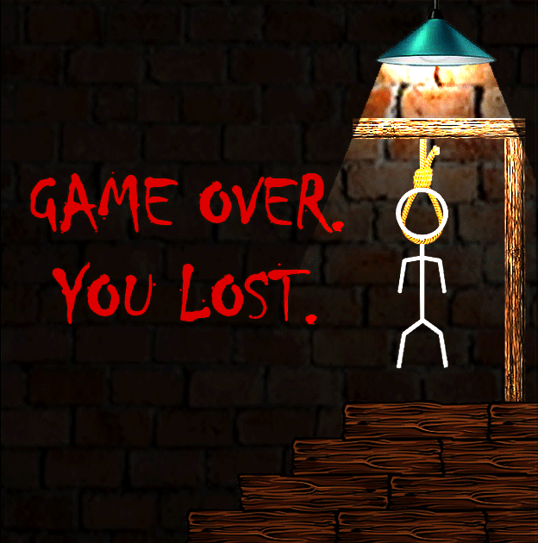

Slide 16
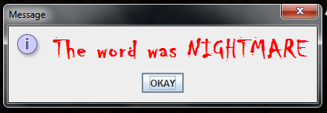

Slide 17
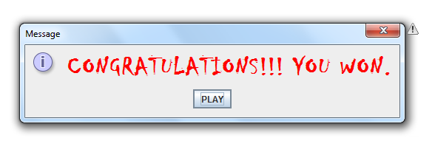

Slide 18
Pros
Makes learning interactive and interesting.
Will help children develop their vocabulary.
Induces interest in children towards learning.
Interactive GUI makes it more fun.

Slide 19
Cons
Reduces students attention span.
Cost of gamified learning is higher than the traditions methods.
Student assessment becomes difficult.

Slide 20
Conclusion
Hangman being an educational game helps children develop their vocabulary and also helps them socialize with other people.
It helps children to think in a lateral way and also from a new perspective.

Slide 21
Future enhancements.
It can be used in educational fields for younger classes to promote interactive learning.
It can be used in game shows.
Database can be expanded to technical fields as well.
Online Publication.
It can me made as an Online Multiplayer Game

Slide 22
References
www.google.com
https://en.wikipedia.org/wiki/Hangman_(game)
https://tophat.com/blog/gamified-learning/

Slide 23
Thank you

